Slide 1
HUB SERVER
INSTALATION

Slide 2
AGENDA
Install Hub Server
Install ActiveVOS

Slide 3
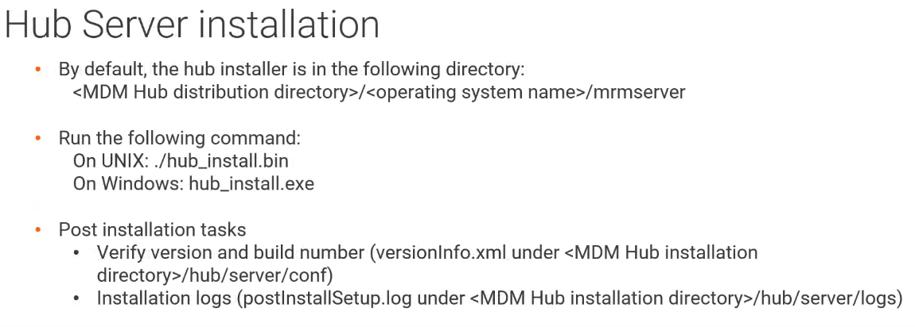
HUB SERVER

Slide 4
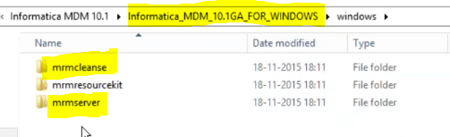
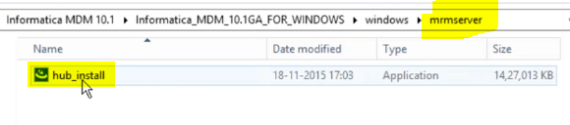
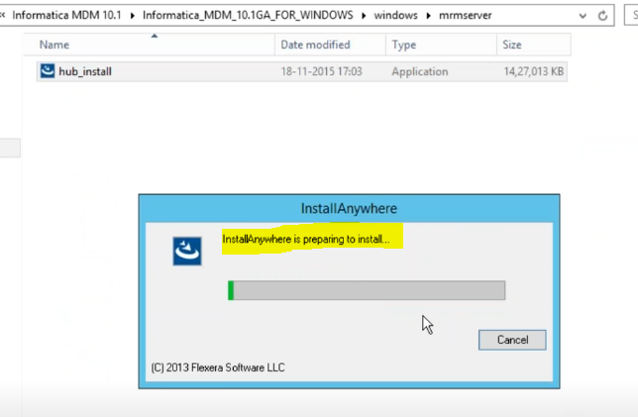
HUB SERVER
Once you download MDM software, Hub Server Installation file will be in “MRMSERVER” folder.
Inside “MRMSERVER” folder, you will get ‘hub_install’ executable file.

Slide 5
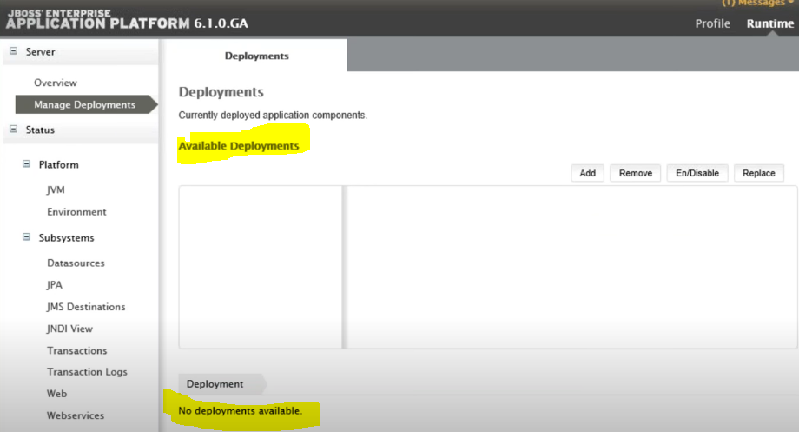
HUB SERVER
Before Hub Server Installation starts, in Jboss app you can see “no deployment” available.

Slide 6
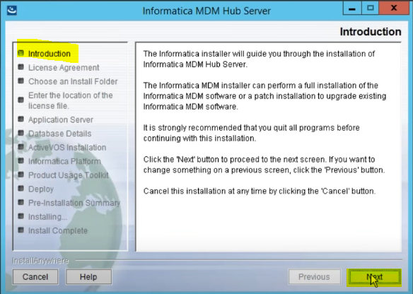
HUB SERVER
Installation starts.

Slide 7
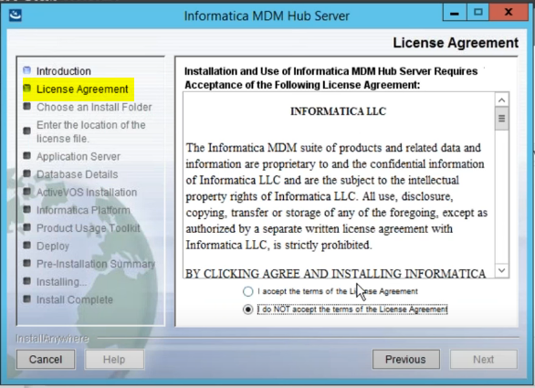
HUB SERVER
Accept the License and Agreement.

Slide 8
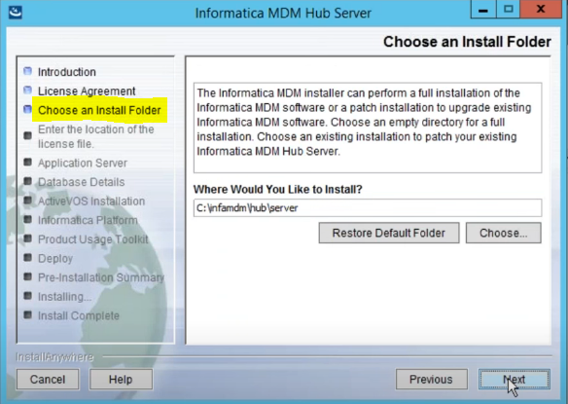
HUB SERVER
Select Install Folder.

Slide 9
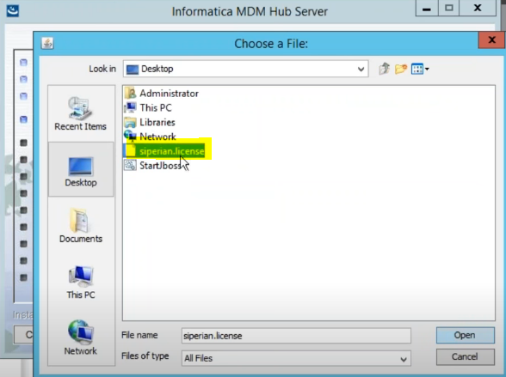
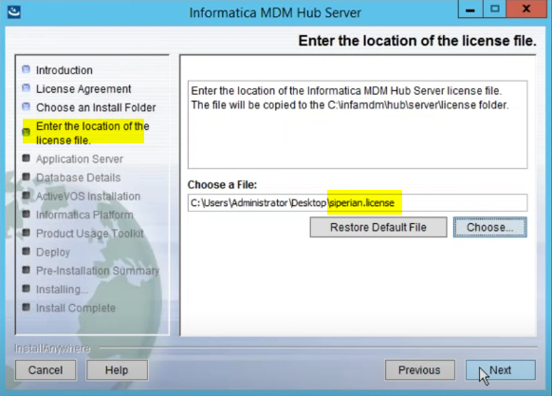
HUB SERVER
Select License File which you will get from Informatica

Slide 10
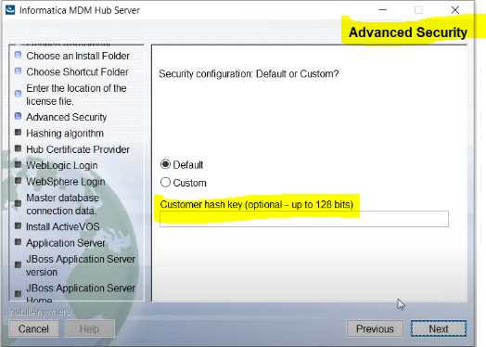
HUB SERVER
Advance Security Option.

Slide 11
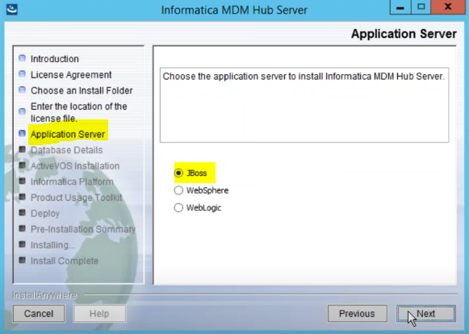
HUB SERVER
Select Application Server.

Slide 12
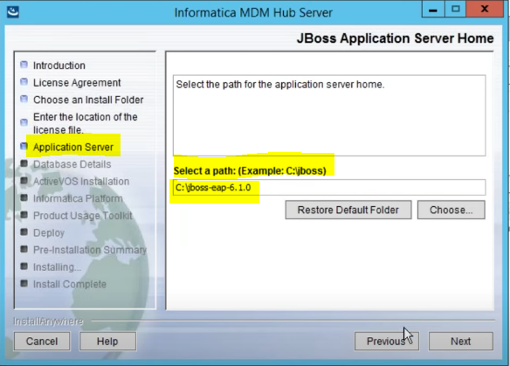
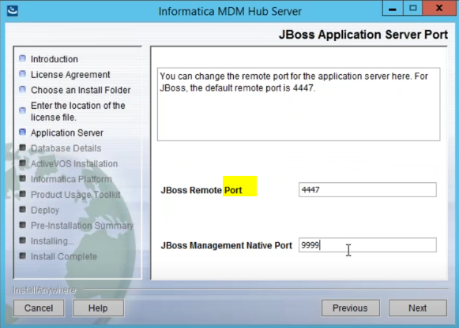
HUB SERVER
Select Application Server path.
Provide Port Information.

Slide 13
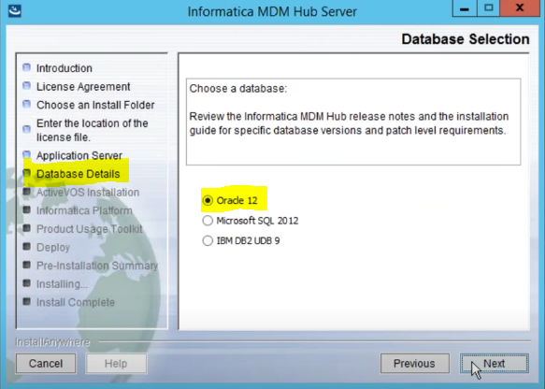
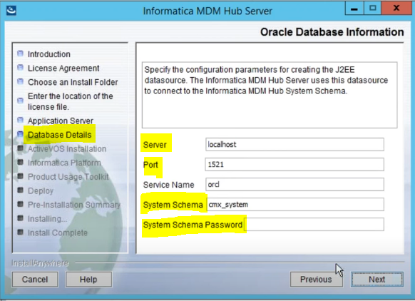
HUB SERVER
Select Required DB.
Provide DB info like Host, Port, Schema.
Provide MASTER schema info. Which is CMX_SYSTEM here, we created during Hub Store Installation.

Slide 14
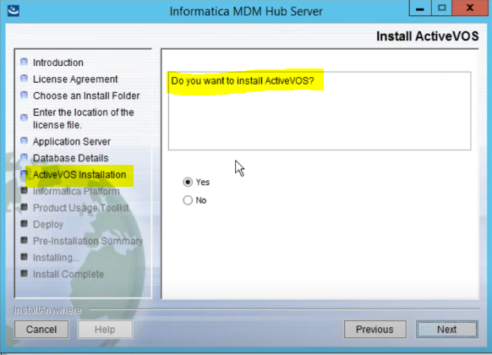
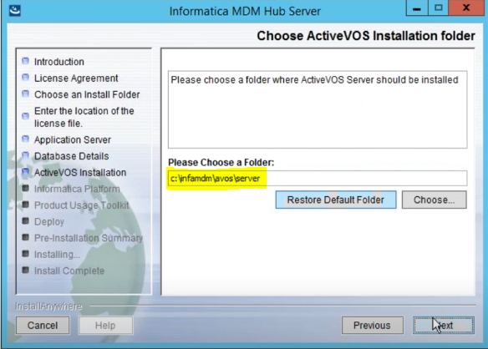
HUB SERVER
Select “ACTIVEVOS” if required.
Provide Folder details, where “ACTIVEVOS” will be installed.

Slide 15
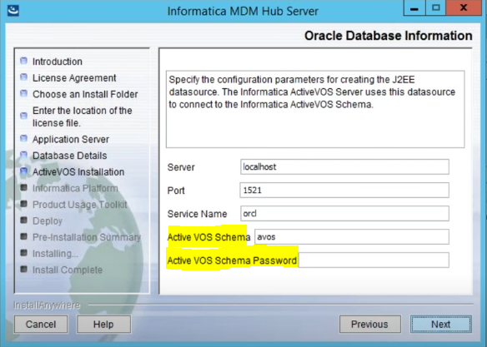
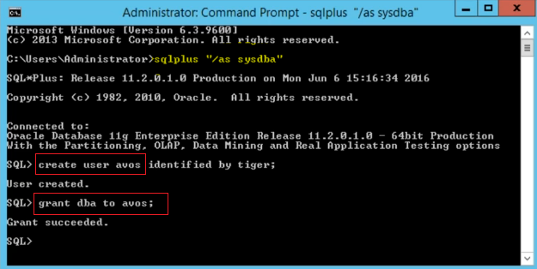
HUB SERVER
Create “avos” user.
If you have done this during Hub Store setup, you can skip this.
Connect to ORACLE DB and create user AVOS.
Provide DBA access.

Slide 16
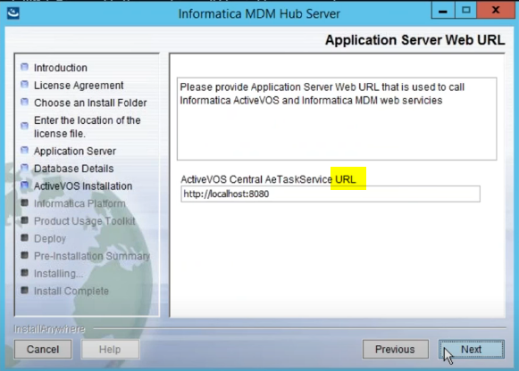
HUB SERVER
Provide ACTIVEVOS url.

Slide 17
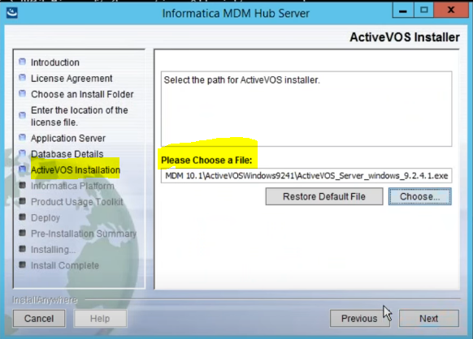
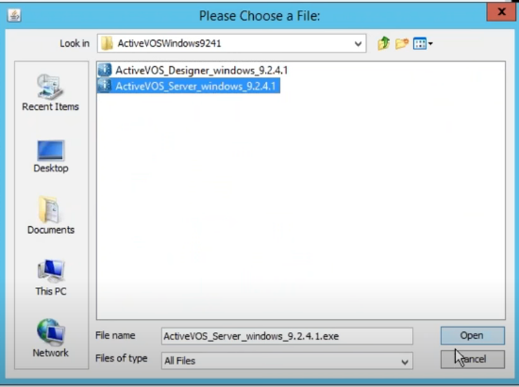
HUB SERVER
Provide ACTIVEVOS url.
Select ActiveVOS installer file, this you will get as part of MDM software.
ActiveVOS designer is for development.

Slide 18
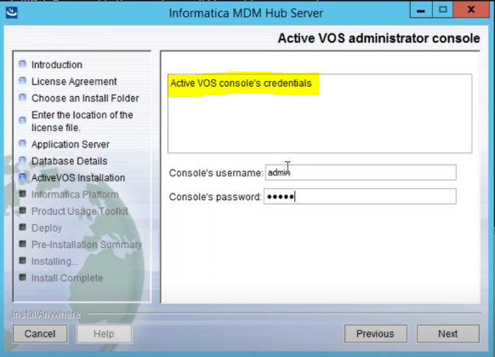
HUB SERVER
Provide ActiveVOS console creadential.

Slide 19
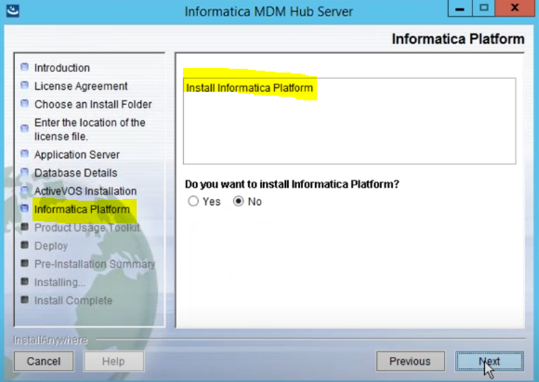
HUB SERVER
If you want to Install IDQ platform, select Yes or No

Slide 20
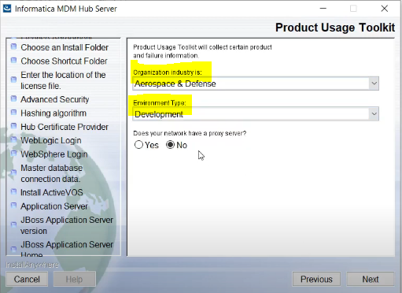
HUB SERVER
Select Environment and Organization Info

Slide 21
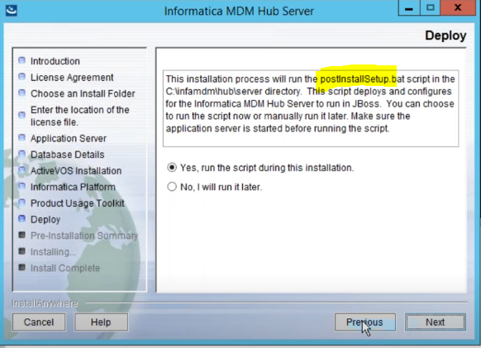
HUB SERVER
Select YES for postInstallation.sh script.
This will resolve if any error occur during installation.

Slide 22
HUB SERVER
Select YES for postInstallation.sh script.
This will resolve if any error occur during installation.

Slide 23
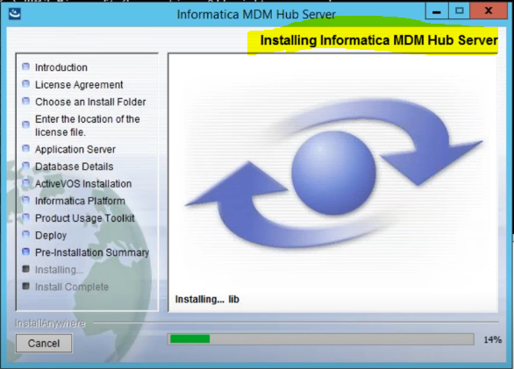
HUB SERVER
Installation Process Starts

Slide 24
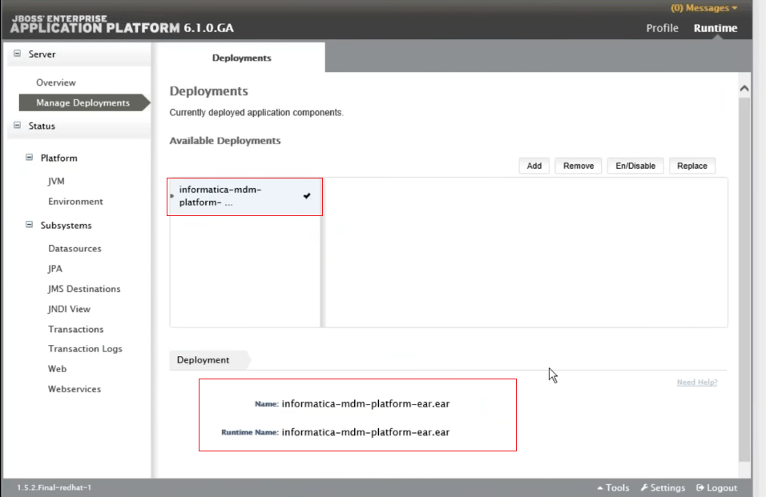
HUB SERVER
You can Check Jboss app client to see what all deployment is going on.
In UNIX/LINUX in “Deployment” folder you can see “< >.ear.isdeplying” files to know what all deployment happening.

Slide 25
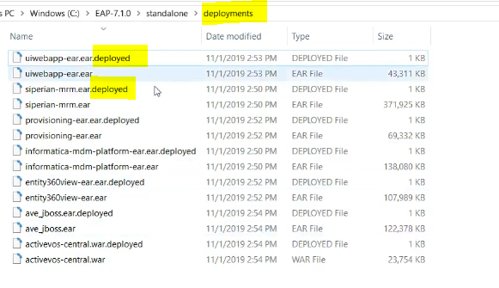
HUB SERVER
Check Deployment Folder to understand what all component installed.

Slide 26
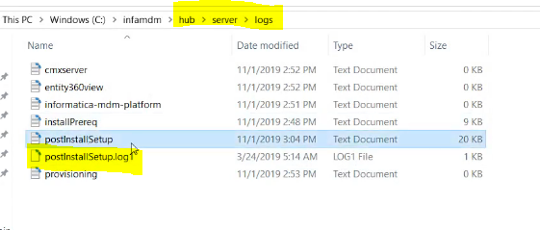
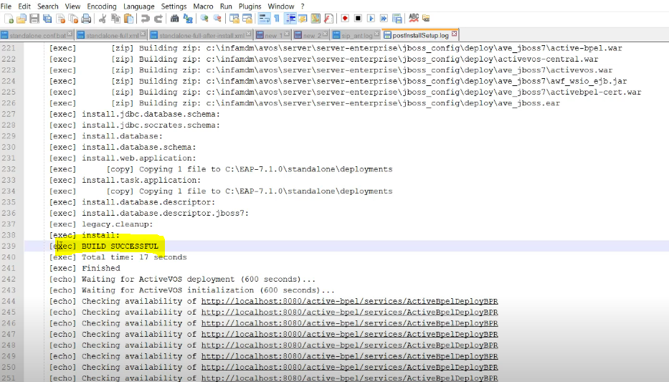
HUB SERVER
Post Install Log Folder and Files
PATH: Hub → Server → Logs
File: postInstallsetup.log

Slide 27
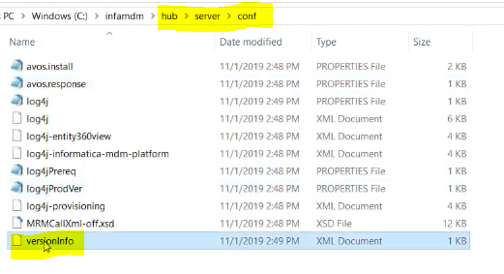
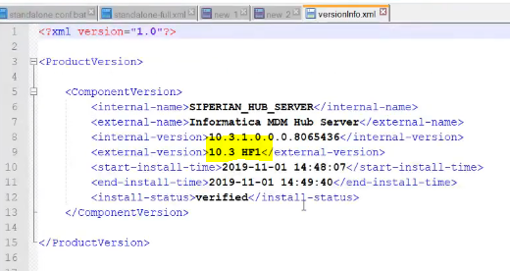
HUB SERVER
Post Install you can verify the version info to confirm Hub Server E2E installation is successful.
PATH: Hub → Server → conf
File: versioninfo

